Slide 1
NewSQL,VoltDB,& H-Store
Based on Presentation given by
Michael Stonebraker, CTO VoltDB, Inc.
CMPUT391

Slide 2
“Big Data”?
Big volume
  I have too much data
Big velocity
  Data is coming at me too fast
Big variety
  I have too many data sources
CMPUT391

Slide 3
Traditional Transaction Processing
Remember how we used to buy airplane tickets in the 1980s
  By telephone
  Through an intermediary (professional terminal operator)
Commerce at the speed of the intermediary
In 1985, 1,000 transactions per second was considered an incredible stretch goal!!!!
  HPTS (1985)
CMPUT391

Slide 4
Traditional Transaction Processing
Workload was a mix of updates and queries
To an ACID data base system
  Make sure you never lose my data
  Make sure my data is correct
At human speed
Bread and butter of RDBMSs (OldSQL)
CMPUT391

Slide 5
How has TP Changed in 25 Years?
The internet
  Client is no longer a professional terminal operator
  Instead Aunt Martha is using the web herself
  Sends TP volume through the roof
  Serious need for scalability and performance
CMPUT391

Slide 6
How has TP Changed in 25 Years?
PDAs
  Your cell phone is a transaction originator
  Sends TP volume through the roof
  Serious need for scalability and performance
Need in some traditional markets
for much higher performance!
CMPUT391

Slide 7
And TP is Now a Much Broader Problem
(New TP)
The internet enables a green field of new TP applications
  Massively multiplayer games (state of the game, leaderboards, selling virtual goods are all TP problems)
  Social networking (social graph is a TP problem)
  Real time ad placement
  Real time couponing
  And TP volumes are ginormous!!
  Serious need for speed and scalability!
CMPUT391

Slide 8
And TP is Now a Much Broader Problem
Electronic commerce is here
  Wall Street electronic trading
  Real-time fraud detection
  Micro transactions (through your PDA)
  And TP volumes are ginormous!!
  Serious need for speed and scalability!
CMPUT391

Slide 9
Add in High Velocity Ingest
  Real time click stream analysis
  Most anything upstream from Hadoop
  Or your data warehouse
  Real time risk assessment on Wall Street
  And TP volumes are ginormous!!
  Serious need for speed and scalability!
CMPUT391

Slide 10
In all cases…..
Workload is a mix of updates and queries
Coming at you like a firehose
Still an ACID problem
  Don’t lose my data
  Make sure it is correct
Tends to break traditional solutions
  Scalability problems (volume)
  Response time problems (latency)
CMPUT391

Slide 11
Reality Check -- Size
TP data base size grows at the rate transactions increase
1 Tbyte is a really big TP data base
1 Tbyte of main memory buyable for around $50K
  (say) 64 Gbytes per server in 16 servers
I.e. Moore’s law has eclipsed TP data base size
If your data doesn’t fit in main memory now, then wait a couple of years and it will…..
CMPUT391

Slide 12
To Go a Lot Faster You Have to……
Focus on overhead
  Better B-trees affects only 4% of the path length
Get rid of ALL major sources of overhead
  Main memory deployment – gets rid of buffer pool
    Leaving other 75% of overhead intact
    i.e. win is 25%
CMPUT391

Slide 13
Solution Choices
OldSQL
  Legacy RDBMS vendors
NoSQL
  Give up SQL and ACID for performance
NewSQL
  Preserve SQL and ACID
  Get performance from a new architecture
CMPUT391

Slide 14
OldSQL
Traditional SQL vendors (the “elephants”)
  Code lines dating from the 1980’s
  “bloatware”
  Mediocre performance on New TP
CMPUT391

Slide 15
NoSQL
Give up SQL
Give up ACID
CMPUT391

Slide 16
Who Needs ACID?
Funds transfer
  Or anybody moving something from X to Y
Anybody with integrity constraints
  Back out if fails
  Anybody for whom “usually ships in 24 hours” is not an acceptable outcome
Anybody with a multi-record state
  E.g. move and shoot
CMPUT391

Slide 17
Who needs ACID in replication
Anybody with non-commutative updates
  For example, + and * don’t commute
Anybody with integrity constraints
  Can’t sell the last item twice….
Eventual consistency means “creates garbage”
CMPUT391

Slide 18
NoSQL Summary
Appropriate for non-transactional systems
Appropriate for single record transactions that are commutative
Not a good fit for New TP
Use the right tool for the job
CMPUT391

Slide 19
NewSQL
SQL
ACID
Performance and scalability through modern innovative software architecture
CMPUT391

Slide 20
NewSQL
Needs something other than traditional record level locking (1st big source of overhead)
  timestamp order
  MVCC
  Your good idea goes here
CMPUT391

Slide 21
NewSQL
Needs a solution to buffer pool overhead (2nd big source of overhead)
  Main memory (at least for data that is not cold)
  Some other way to reduce buffer pool cost
CMPUT391

Slide 22
NewSQL
Needs a solution to latching for shared data structures (3rd big source of overhead)
  Some innovative use of B-trees
  Single-threading
  Your good idea goes here
CMPUT391

Slide 23
NewSQL
Needs a solution to write-ahead logging (4th big source of overhead)
  Obvious answer is built-in replication and failover
  New TP views this as a requirement anyway
Some details
  On-line failover?
  On-line failback?
  LAN network partitioning?
  WAN network partitioning?
CMPUT391

Slide 24



Summary
Old TP
New TP
OldSQL for New OLTP |  | Too slow Does not scale
NoSQL for New OLTP |  | Lacks consistency guarantees Low-level interface
NewSQL for New OLTP |  | Fast, scalable and consistent Supports SQL
CMPUT391

Slide 25
A NewSQL Example: H-Store/VoltDB
Main-memory Linux SQL DBMS
  Anti-caching
Multi-node and sharded
Stored procedure interface
  No locking
Pure ACID
Single threaded
Built-in HA and durability
  No log (in the traditional sense)
CMPUT391

Slide 26
Anti-caching
Main memory format for data
When memory fills
  Gather col tuples and write to an archive
When a transaction has a “miss”
  Abort it
  Find all the absent data
  Reschedule transaction when all needed data in memory
CMPUT391

Slide 27
What About Multicore?
For A K-core CPU, divide memory into K (non overlapping) buckets
i.e. convert multi-core to K single cores
CMPUT391

Slide 28
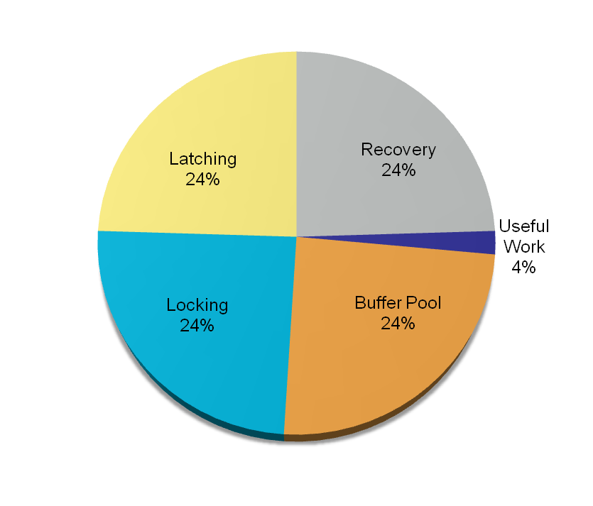
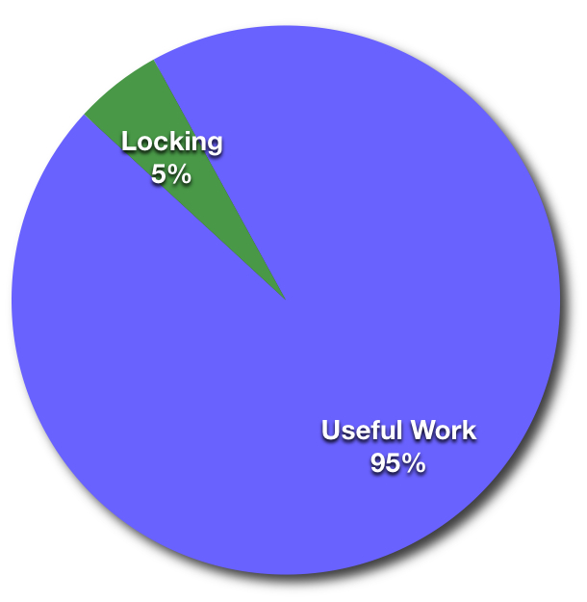
Where all the time goes… revisited
Before
VoltDB
CMPUT391

Slide 29
Current VoltDB Status
Runs a subset of SQL (which is getting larger)
On VoltDB clusters (in memory on commodity gear)
With LAN and WAN replication
70X a popular OldSQL DBMS on TPC-C
5-7X Cassandra on VoltDB K-V layer
Scales to 384 cores (biggest iron we could get our hands on)
Clearly note this is an open source system!
CMPUT391

Slide 30
Performance of H-Store
 | Simplified TPC-C with stored procedures
Partitions | 16 | 64
Number of concurrent clients | Not available | not available
Only local partition accesses | 39,000 | 140,000
30% remote partition accesses | 7,000 | 18,000
ACM CIMK 2014

